Slide 1

GCT MC Task List
12th June 2018, GCT-MC Call
Thomas Armstrong

Slide 2
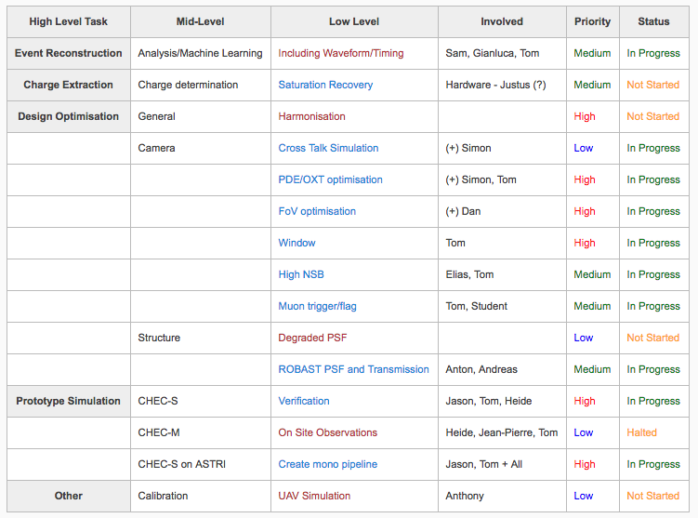
Task List
https://forge.in2p3.fr/projects/gct/wiki/CameraMC

Slide 3
GCT MC Model V&V
24th April 2018, Monthly GCT-MC Call
Thomas Armstrong

Slide 4
Structure
https://forge.in2p3.fr/projects/cta_analysis-and-simulations/repository/changes/Simulations/MCModelDescription/trunk/reports/SST-2M-GCT-S.pdf
WP review:
Focal Length 228.3 cm (Should be agreed?)
Mirror reflectivity (measurement to be provided ~July)
Mirror reflection random angle (same as above?)
Telescope transmission (in discussion)
Camera body diameter (in discussion)
Camera depth (in discussion)
Primary mirror parameters (Should be agreed?)
Primary Segmentation (in discussion)
Focal surface parameter (Should be agreed?*)
Pixels parallel (Should be agreed?*)
7/18 parameters agreed

Slide 5
Camera
WP review:
All…

Slide 6
Camera
Easy to agree:
Camera pixels = 2048
Cathode Shape = Square
Cathode Diameter = 0.623cm?
Funnel Depth = 0
PM Voltage Variation = 0 (not relevant)
PM transit time = 4ns (not relevant)
Photon Delay =5ns (not relevant)
Discriminator bins =120
Discriminator start =3
Default trigger = Majority
Discriminator Amplitude = 1 (sets amplitude to units of p.e.)
Trigger Pixels = 2
Trigger Delay Compensation = 0
Teltrig min sigsum = 0
Discriminator sigsum (+var) over threshold =0
Discriminator gate length = -8 ns
Discriminator Rise/Fall Time = 0ns
Discriminator Hysteresis = 0
Discriminator Output Amplitude = 1
Discriminator Output Var Percent = 0
FADC MHZ = 1000 MHz
FADC Bins = 128?
FADC Sum Bins = 96? – 128?
FADC Sum Offset =24?
Num Gains = 1
Could at least be 29/47 agreed parameters.

Slide 7
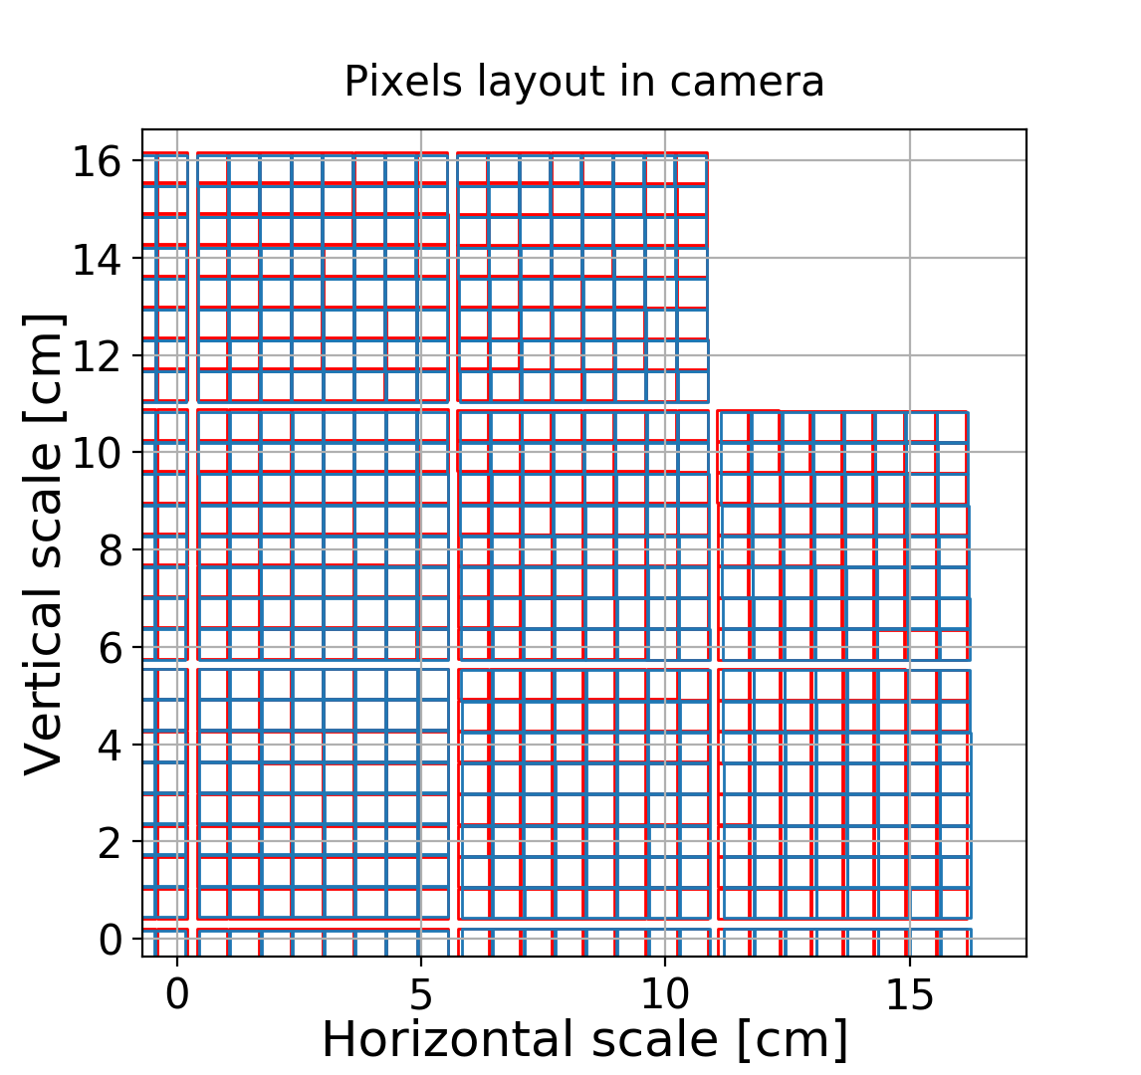
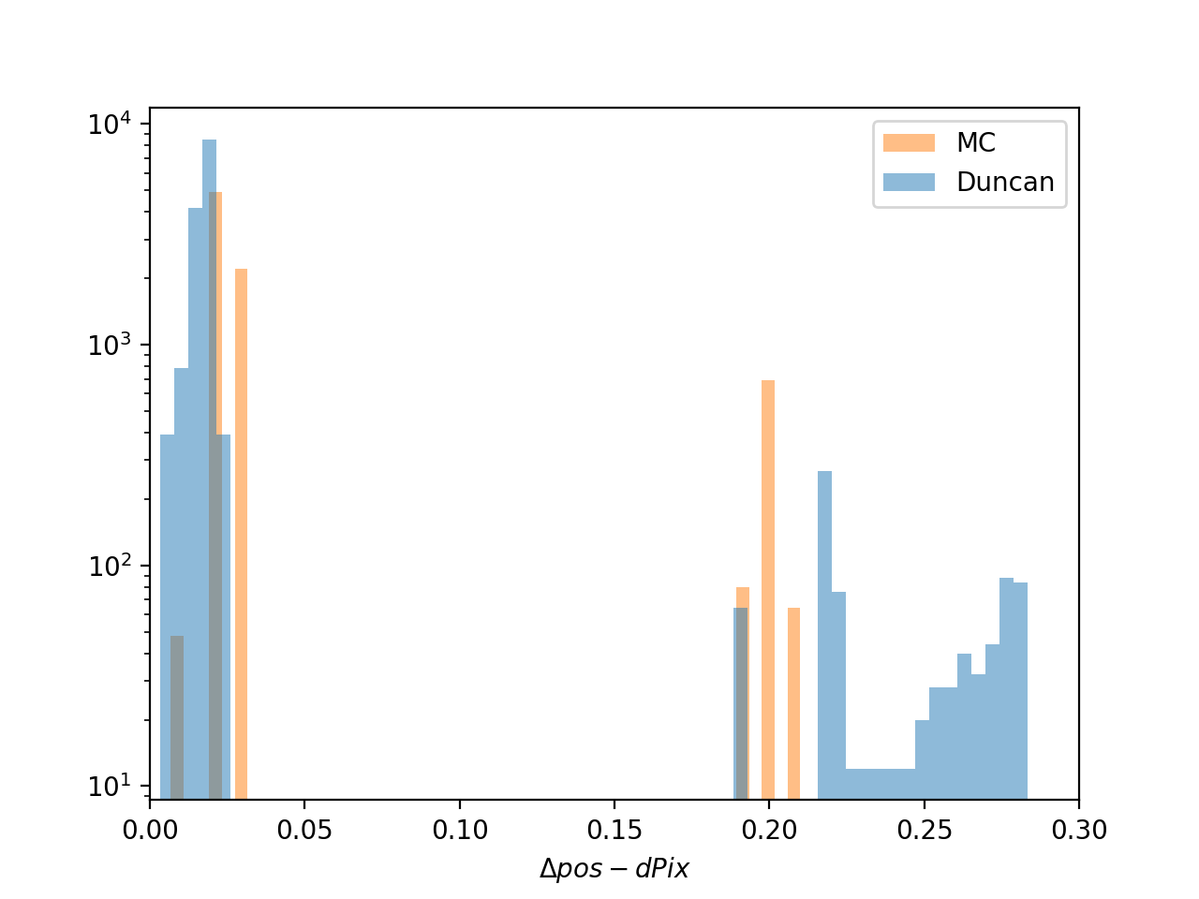
Pixel Positions
Output of pixel positions provided by Duncan
Worried about deadspace?
B-SST-1160 Deadspace: The largest dead spaces (non-photosensitive surfaces) must be narrower than θ₈₀/4 at any place within the required FoV.
Within module
Between module

Slide 8
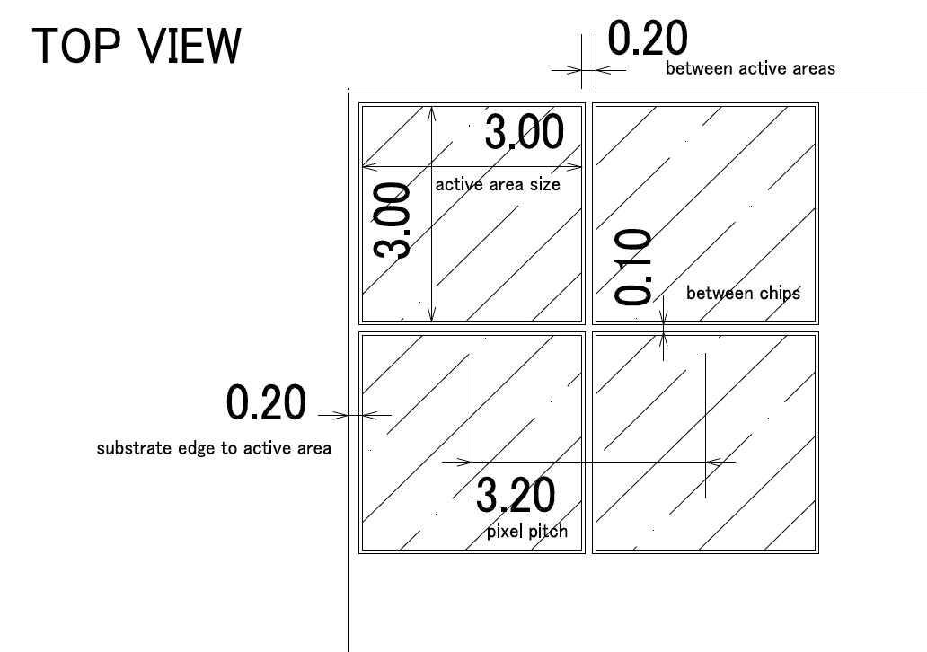
Pixel Positions
Output of pixel positions provided by Duncan
Worried about deadspace?
B-SST-1160 Deadspace: The largest dead spaces (non-photosensitive surfaces) must be narrower than θ₈₀/4 at any place within the required FoV.
Within module
Between module

Slide 9
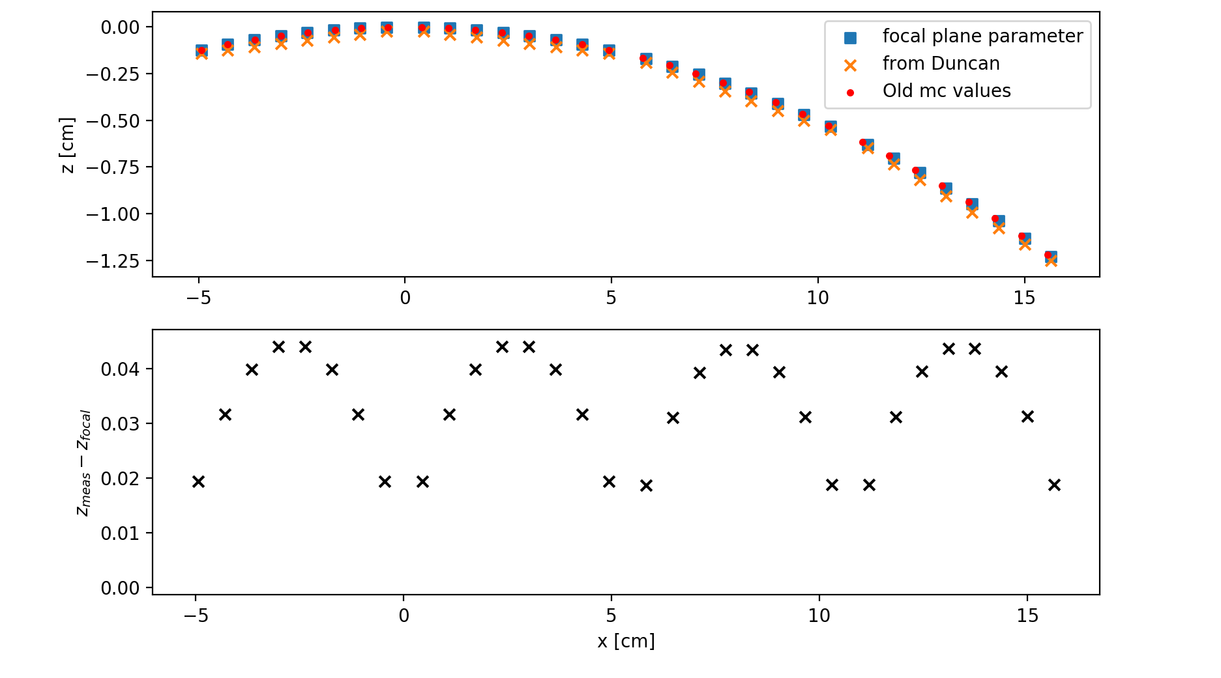
Pixel Positions
Output of pixel positions provided by Duncan
Worried about deadspace?
B-SST-1160 Deadspace: The largest dead spaces (non-photosensitive surfaces) must be narrower than θ₈₀/4 at any place within the required FoV.

Slide 10
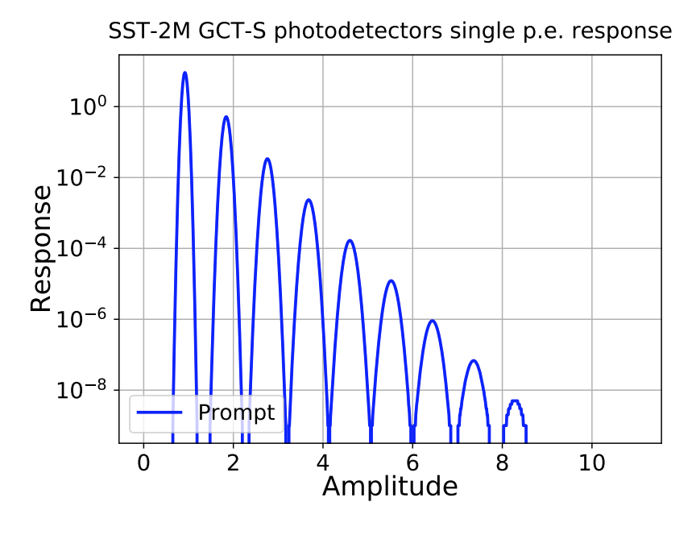
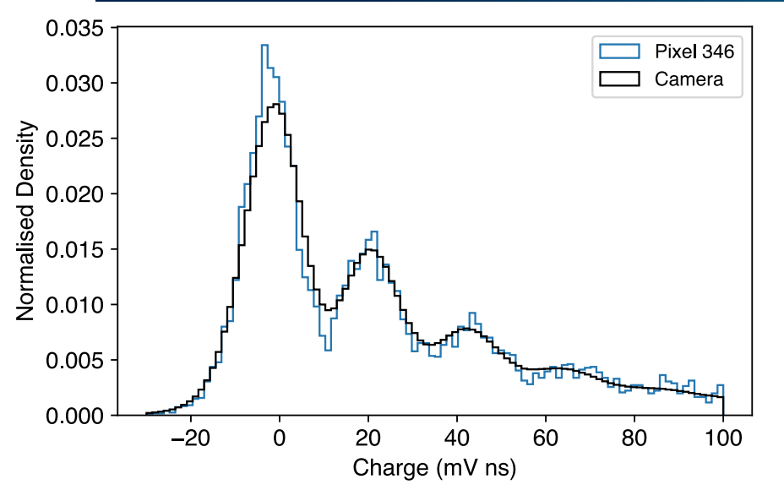
SPE curve
Needs updating – Should be able to provide values from recent measurements?

Slide 11
Gain Variations
Fractional gain variation between different photodetectors after adjusting the voltage to have approximately the same gain in all channels. The parameter sets the Gaussian r.m.s. spread of random fluctuations, used as amplitude *= RandGaus(1., gain_variation).
Current = 0.05
Discussed =0.10 – 0.12
Need plot and final value

Slide 12
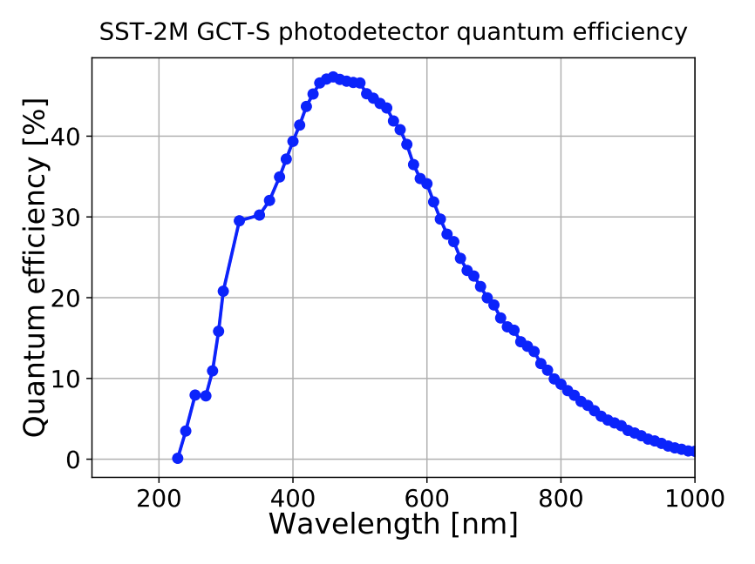
QE
Needs updating

Slide 13
QE Variation
Photoelectron collection efficiency variation (Gaussian r.m.s. spread of random fluctuations) between photodetectors.
Current = 0.04
Discussed = 0.025?
Need plot and final value

Slide 14
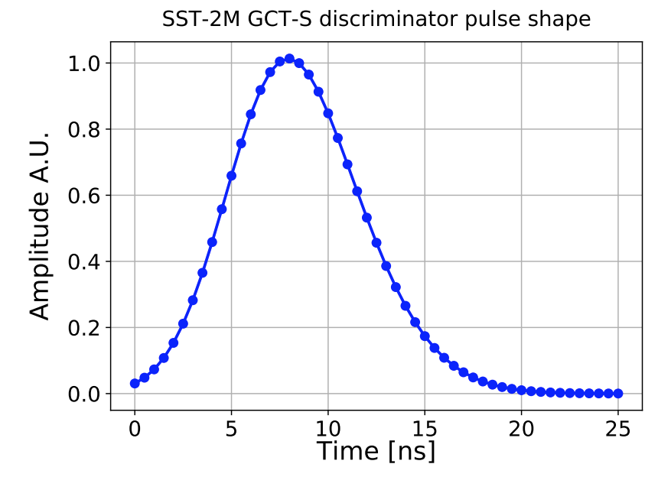
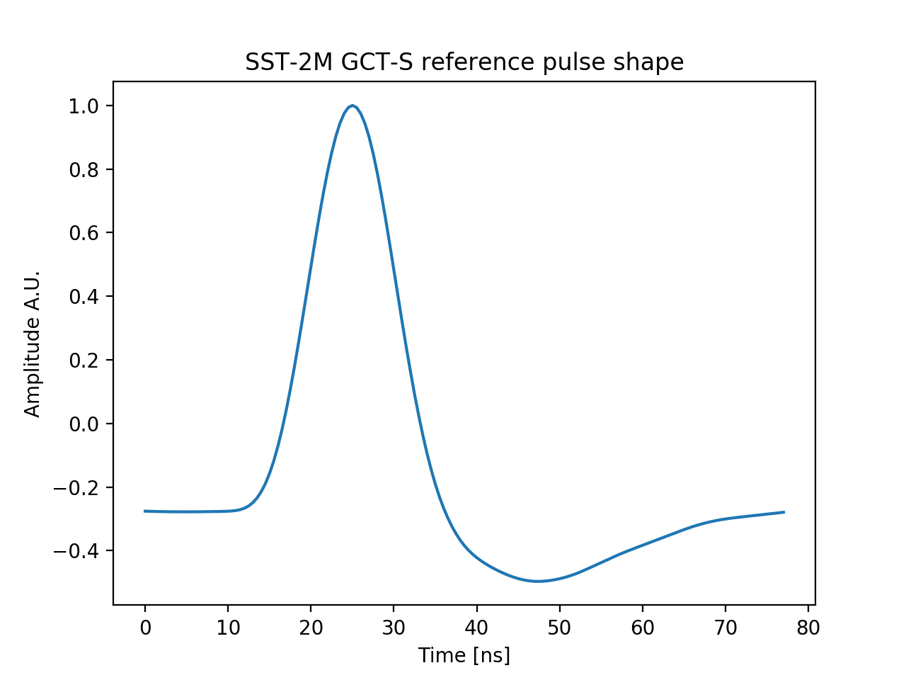
Pulse Shape
Discriminator and FADC

Slide 15
Transit Time Jitter/Teltrig Min Time
Transit Time Jitter: Jitter (Gaussian r.m.s. spread of random fluctuations) of individual photo-electrons in nanoseconds.
Current = 0.2
Discussed =
Need conclusion of Adrian's work including Backplane effects
Minimum time of sector trigger over threshold. Used before telescope trigger.
Current = 0.5 ns
Discussed = probably fine?
Needs plot and final value

Slide 16
Discriminator
Gate length: Effective discriminator gate length. To achieve a comparator-type response this gate length must match the time over threshold below
Current = 8 ns
Discussed = -8 ns (~Agreed)
Var gate length: Variation of gate length (Gaussian r.m.s.). In comparator-type response, this variable is not used but only discriminator var time over threshold.
Current = 1 ns
Discussed = 0.5 ns? (better in future)
Var threshold: Channel-to-channel variations (random Gaussian r.m.s.) of discriminator/comparator threshold.
Current = 2 mV
Discussed = 0.8 p.e. (but does vary with illumination level)
Time over threshold: Time over threshold required before logic response switches to true. To achieve a comparator-type response this time must match the gate length above. Note that in addition a minimum signal integral discriminator sigsum over threshold may be set up. If so, both time over threshold and signal integral conditions have to be met before a ‘true’ output signal starts. Normally, either of them being non-zero should be sufficient.
Current = 1 ns
Discussed = difficult to measure, but should be shorter?

Slide 17
FADC
Pedestal: Nominal (F)ADC pedestal value per time slice.
Current = 40 ADC counts
Discussed ?
Ped Var: Channel-to-channel (or pixel-to-pixel) variation of the pedestal per FADC time slice
Current = Default of 0.75 (ADC counts?)
Not discussed
Amplitude: Peak amplitude at ADC/FADC (for high gain channel, if different gains are used). fadc amplitude are ADC counts maximum amplitude above pedestal (per time slice) for a photo-electron with average (not most probable) signal. This is after photodetector, preamplifier, cable, and shaper at the input of the ADC or FADC
Current = 8 ADC counts
Discussed = 6 ?
Noise: Gaussian r.m.s. spread of white noise per time bin in digitisation (for high-gain channel, if different gains are used).
Current = 2 ADC counts
Discussed = Looks ok?

Slide 18
ASWG Meeting
24th April 2018, Monthly GCT-MC Call
Thomas Armstrong

Slide 19
Overview
See Gernot’s Overview Talk: https://indico.cta-observatory.org/event/1686/sessions/2306/attachments/13460/16226/CTA-20180420-ASWGDiscussions.pdf
Lots of talk of getting more organized, setting up dedicated smaller Task Groups
Hadronic interaction models
Model updates
*Realistic/Aged Telescopes
MC SCT
*Data reduction
Baseline Analysis and Benchmark tests
Camera calibration
*Simulation optimization
Short-term sensitivity
Divergent Pointing
Machine Learning
*IRFs and science tools interface (with DPPS)
*Systematic uncertainties
*Ozone studies
*Event classes (with PHYS)
*Surveys (with PHYS)
*High Angular Resolution IRFs
System tests
*Geomagnetic field
*Electrons
…

